Slide 1
ARTIFIAL NEURAL NETWORK
Bakul Gohel, Ph.D.
DA-IICT, Gandhinagar

Slide 2
Artificial Neural Network
Neuron is the functional and structural unit of the brain (biological neural network)
Perceptron/artificial neural network loosely inspired by Biological neuron/neural network

Slide 3
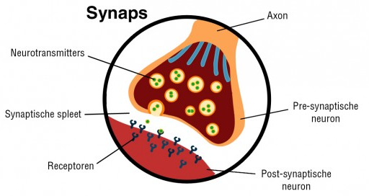
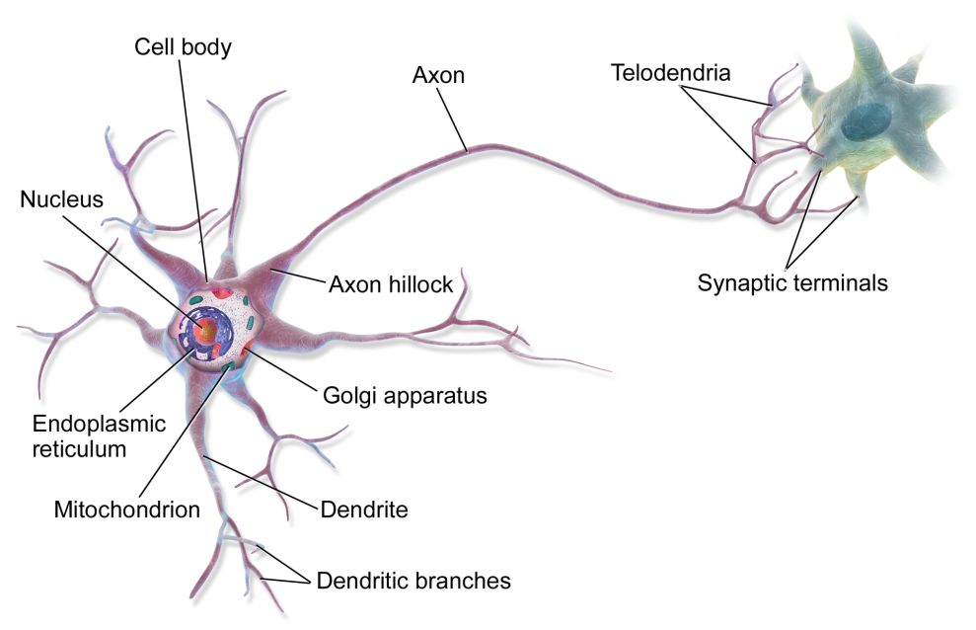
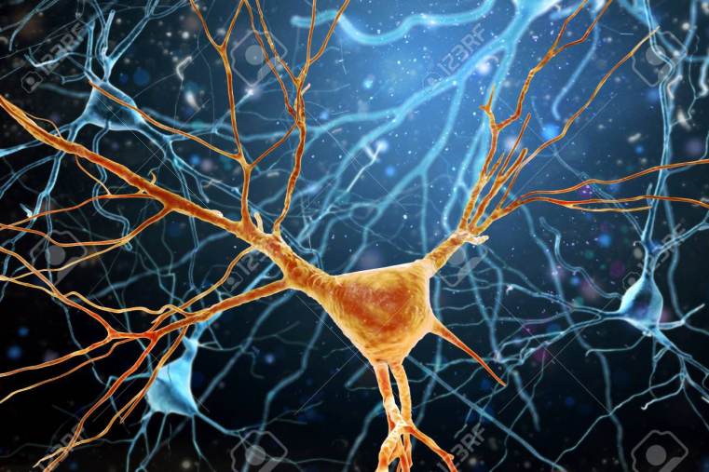
Biological Neuron
Neuron and Synapse
http://www.brainmatters.nl/wp-content/uploads/synaps-570x272.jpg
https://en.wikipedia.org/wiki/Neuron#/media/File:Blausen_0657_MultipolarNeuron.png

Slide 4
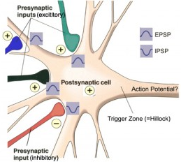
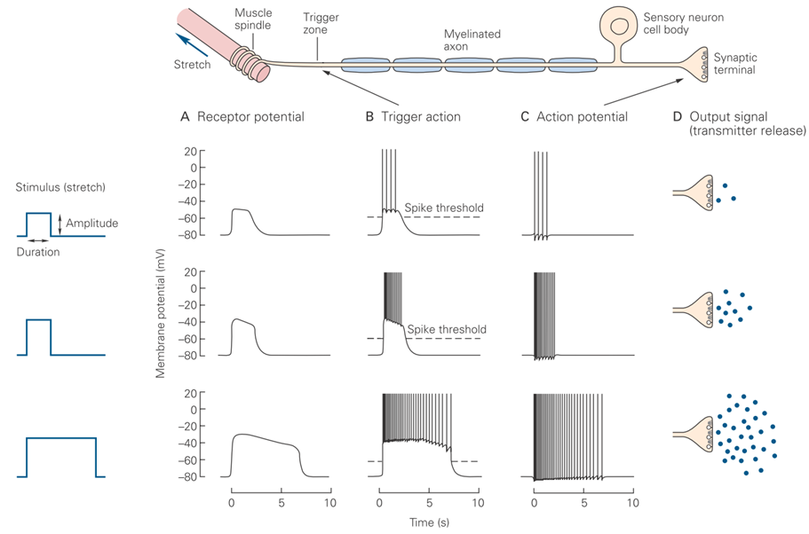
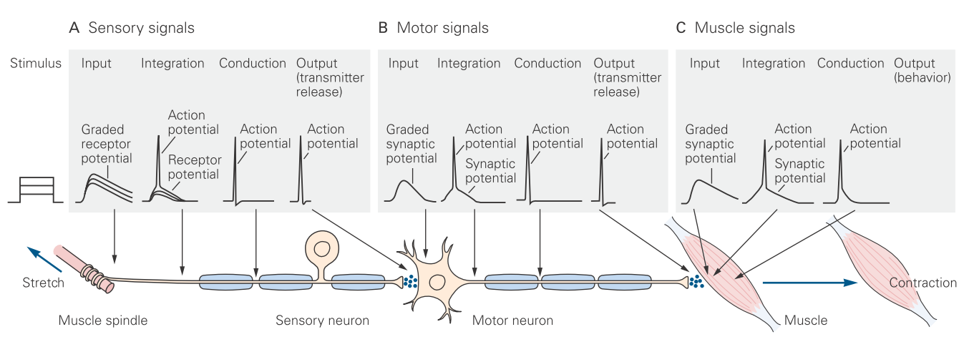
Biological Neuron
Input:- Excitatory/Inhibitory
post synaptic potential
Internal Processing: Action Potential
Output: Neurotransmitter/Action

Slide 5











Perceptron – an artificial neuron
$$w_{1}$$
$$x_{1}$$
$$w_{2}$$
$$x_{2}$$
$$z=\sum_{i}{w_{i}x_{i}}$$
$$⋮$$
$$g(z)$$
$$y$$
$$⋮$$
$$w_{n}$$
$$x_{n}$$
Neuron Output
(Neurotransmitter !)
Synaptic Weight
Synaptic Integration
Pre-synaptic
Input

Slide 6
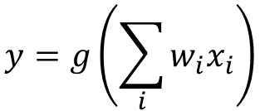



Perceptron – an artificial neuron
$$w_{1}$$
$$x_{1}$$
$$w_{2}$$
$$x_{2}$$
$$z=\sum_{i}{w_{i}x_{i}}$$
$$⋮$$
$$g(z)$$
$$y$$
$$⋮$$
$$w_{n}$$
$$x_{n}$$
$$y=g\left(\sum_{i}{w_{i}x_{i}}\right)$$
H$ow to choose g$ ?

Slide 7
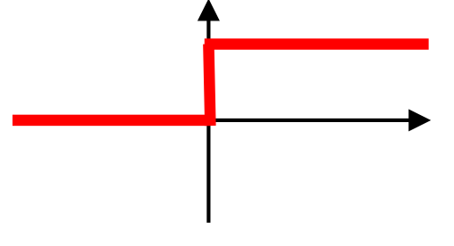

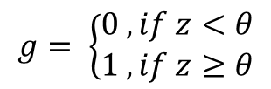

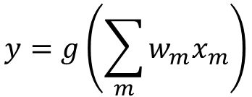
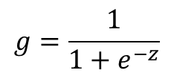



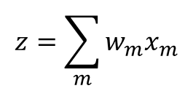
Perceptron – an artificial neuron
$$y=g\left(\sum_{m}{w_{m}x_{m}}\right)$$
$$z=\sum_{m}{w_{m}x_{m}}$$
$$y=g\left(z\right)$$
$$g= \left\{\begin{aligned}0 , if z<θ \\ 1 , if z≥θ\end{aligned}\right.$$
Standard Perceptron MODEL
$$g=z$$
Linear Multiple Regression (with MSE loss)
$$g(z)$$
$$g=\frac{1}{1+e^{−z}}$$
Logistic Regression (with BCE loss)
$$z$$

Slide 8
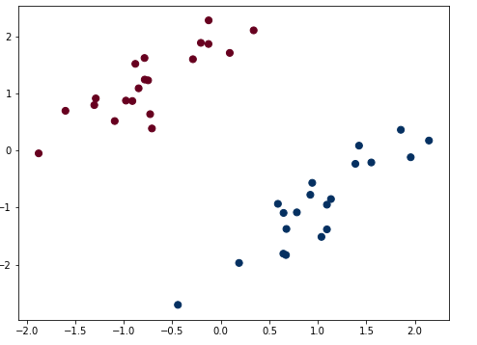
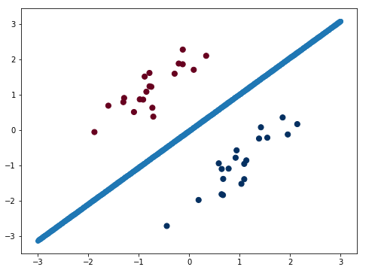
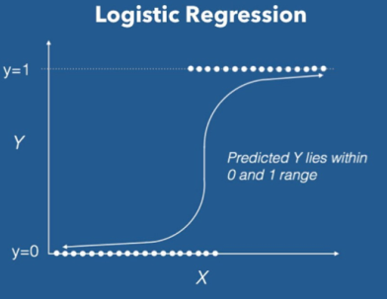
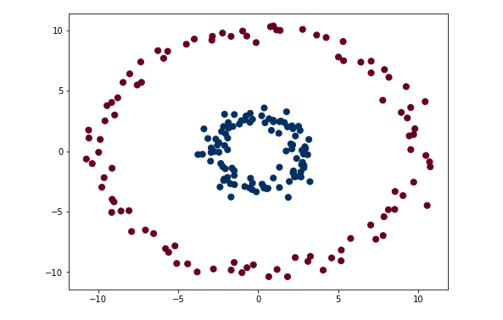
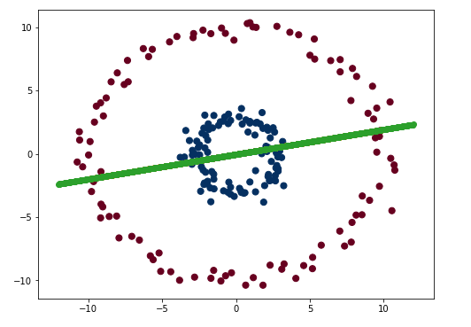
Perceptron
Consider a perceptron as a logistic regression/classification model, But…
Linearly classifiable
Binary – Class
data
✔
✘
Non- Linearly classifiable binary-class
data

Slide 9
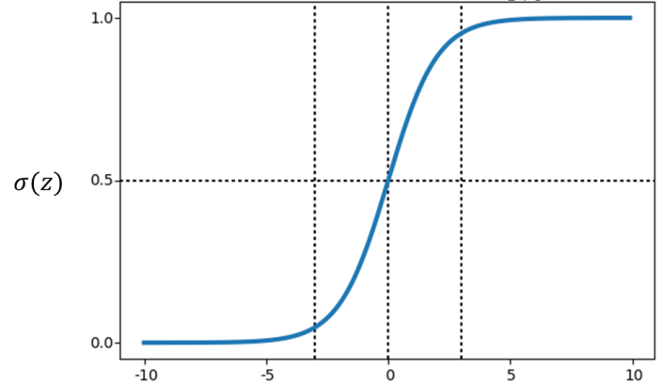
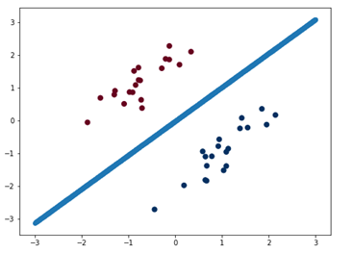

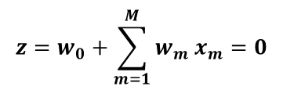
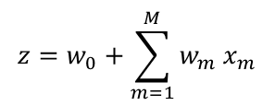



Logistic Regression
Logistic regression classification give you a linear decision boundary
$$y=σ\left(z\right)=\frac{1}{1+e^{−z}}$$
$$z=w_{0}+\sum_{m=1}^{M}{w_{m} x_{m}}$$
$y=σ\left(z\right)=\frac{1}{1+e^{−z}}$ if > 0.5 then class is 1
$y=σ\left(z\right)=\frac{1}{1+e^{−z}}$ if < 0.5 then class is 0
Decision boundary is
$y=σ\left(z\right)=\frac{1}{1+e^{−z}}$ = 0.5
$${z=w}_{0}+\sum_{m=1}^{M}{w_{m} x_{m}}=0$$
Decision boundary is linear equation

Slide 10
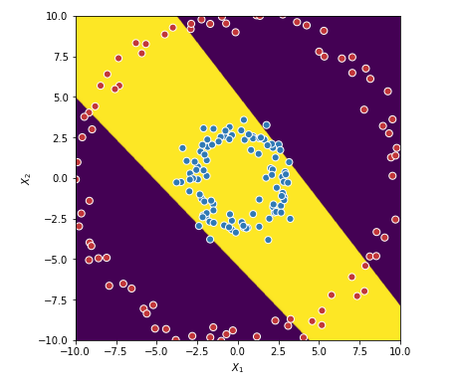
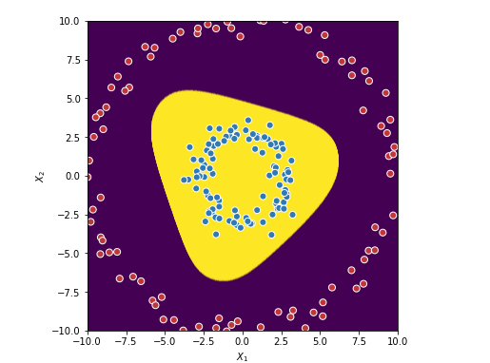

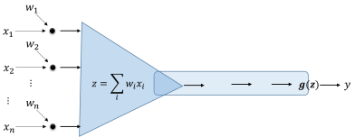
Multilayer Perceptron (MLP)
So single perceptron can not handle non-linear classifiable/regression data
How about using two or more perceptron (logistic)

Slide 11
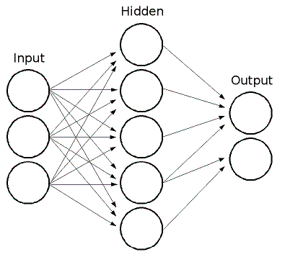
Artificial Neural Network
Stack multiple layer of neurons with Linear and Non-linear activation functions
To learn complex non-linear separating hyperplane
To approximate complex function (Universal approximator…)
No data distribution assumptions

Slide 12
MLP and Error Backpropogation

Slide 13

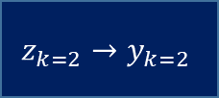

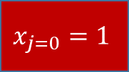



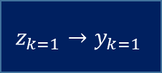

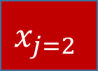

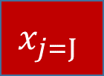
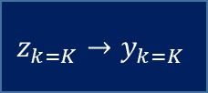
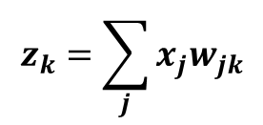

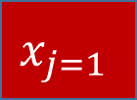
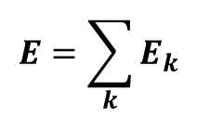

MLP without Hidden Layer
$$z_{k}=\sum_{j}{x_{j}w_{jk}}$$
$$x_{j=0}=1$$
$${y_{k}=g}_{k}\left(z_{k}\right)$$
$g$ is the activation function
$$g$$
$$x_{j=1}$$
$$z_{k=1}→y_{k=1}$$
$$e_{k=1}$$
$$w_{jk}$$
$$g$$
$$E=\sum_{k}{E_{k}}$$
$$z_{k=2}→y_{k=2}$$
$$e_{k=2}$$
$$x_{j=2}$$
$$g$$
$$z_{k=K}→y_{k=K}$$
$$e_{k=K}$$
$$x_{j=J}$$

Slide 14

MLP without Hidden Layer
$$z_{k}=\sum_{j}{x_{j}w_{jk}}$$
$$x_{j=0}=1$$
$${y_{k}=g}_{k}\left(z_{k}\right)$$
$$g$$
$$x_{j=1}$$
$$z_{k=1}→y_{k=1}$$
$$e_{k=1}$$
$$w_{jk}$$
$$g$$
$$E=\sum_{k}{E_{k}}$$
$$z_{k=2}→y_{k=2}$$
$$e_{k=2}$$
$$x_{j=2}$$
$$g$$
$$z_{k=K}→y_{k=K}$$
$$e_{k=K}$$
$$x_{j=J}$$

Slide 15
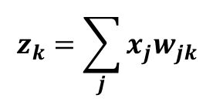
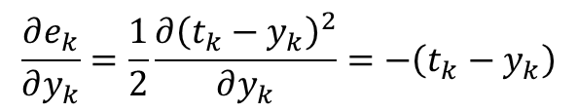

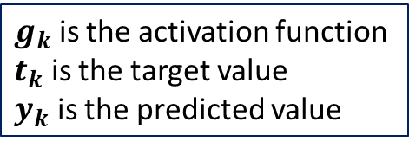
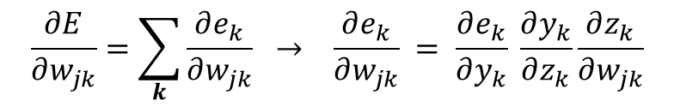
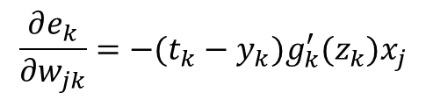
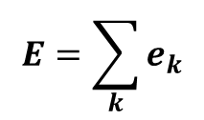
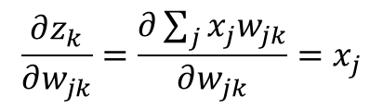
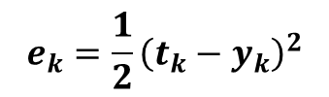
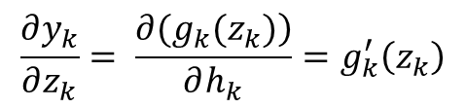

Error Back-Propagation-MSE
$$z_{k}=\sum_{j}{x_{j}w_{jk}}$$
$$e_{k}=\frac{1}{2}{\left(t_{k}−y_{k}\right)}^{2}$$
$g_{k}$ is the activation function
$t_{k}$ is the target value
$y_{k}$ is the predicted value
$$E=\sum_{k}{e_{k}}$$
$${y_{k}=g}_{k}\left(z_{k}\right)$$
$$\frac{∂E}{∂w_{jk}}=\sum_{k}{\frac{∂e_{k}}{∂w_{jk}}} → \frac{∂e_{k}}{∂w_{jk}} = \frac{∂e_{k}}{∂y_{k}} \frac{∂y_{k}}{∂z_{k}}\frac{∂z_{k}}{∂w_{jk}}$$
$$\frac{∂e_{k}}{∂y_{k}}=\frac{1}{2}\frac{∂{\left(t_{k}−y_{k}\right)}^{2}}{∂y_{k}}=−\left(t_{k}−y_{k}\right)$$
$$\frac{∂e_{k}}{∂w_{jk}}=−(t_{k}−y_{k})g_{k}^{′}(z_{k})x_{j}$$
$$\frac{∂y_{k}}{∂z_{k}}= \frac{\left.∂(g_{k}(z_{k})\right)}{∂h_{k}}=g_{k}^{′}\left(z_{k}\right)$$
$$w_{jk}^{t+1}=w_{jk}^{t}−η(−\left(t_{k}−y_{k}\right)g_{k}^{′}\left(z_{k}\right)x_{j})$$
Delta rule
$$\frac{∂z_{k}}{∂w_{jk}}=\frac{∂\sum_{j}{x_{j}w_{jk}}}{∂w_{jk}}=x_{j}$$

Slide 16
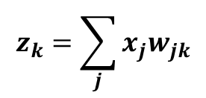
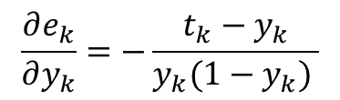

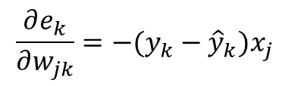
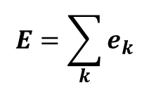
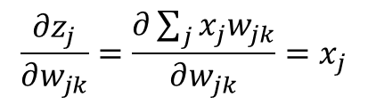



Error Back-Propagation- sigmoid+BCE
$$z_{k}=\sum_{j}{x_{j}w_{jk}}$$
$$e_{k}=−\left(t_{k}logy_{k}+{(1−t}_{k})log{(1−y}_{k}\right))$$
$$E=\sum_{k}{e_{k}}$$
$${y_{k}=σ}_{k}\left(z_{k}\right)$$
$$\frac{∂E}{∂w_{jk}}=\sum_{k}{\frac{∂e_{k}}{∂w_{jk}}} → \frac{∂e_{k}}{∂w_{jk}} = \frac{∂e_{k}}{∂y_{k}} \frac{∂y_{k}}{∂z_{k}}\frac{∂z_{k}}{∂w_{jk}}$$
$$\frac{∂e_{k}}{∂y_{k}}=−\frac{t_{k}−y_{k}}{y_{k}(1−y_{k}) }$$
$$\frac{∂e_{k}}{∂w_{jk}}=−(y_{k}−{\hat{y}}_{k})x_{j}$$
$$\frac{∂y_{k}}{∂z_{k}}= \frac{\left.∂(σ_{k}(z_{k})\right)}{∂h_{k}}=g_{k}^{′}\left(z_{k}\right)$$
$=σ_{k}\left(z_{k}\right)\left(1−σ_{k}\left(z_{k}\right)\right)=y_{k}(1−y_{k})$
$$w_{jk}^{t+1}=w_{jk}^{t}−η(−\left(t_{k}−y_{k}\right)x_{j})$$
$$\frac{∂z_{j}}{∂w_{jk}}=\frac{∂\sum_{j}{x_{j}w_{jk}}}{∂w_{jk}}=x_{j}$$

Slide 17


























ANN with a Hidden Layer
$$z_{j}=\sum_{i}{x_{i}w_{ij}}$$
$$z_{k}=\sum_{j}{y_{j}w_{jk}}$$
$${y_{j}=g}_{j}\left(z_{j}\right)$$
$${y_{k}=g}_{k}\left(z_{k}\right)$$
$$x_{i=0}=1$$
$$y_{j=0}=1$$
$$g$$
$$g$$
$$g$$
$$x_{i=1}$$
$$z_{j=1}→y_{j=1}$$
$$z_{k=1}→y_{k=1}$$
$$g$$
$$E=\sum_{k}{e_{k}}$$
$$w_{jk}$$
$$z_{k=2}→y_{k=2}$$
$$e_{k}$$
$$x_{i=2}$$
$$w_{ij}$$
$$g$$
$$z_{j=2}→y_{j=2}$$
$$g$$
$$z_{k=K}→y_{k=K}$$
$$g$$
$$z_{j=J}→y_{j=J}$$
$$x_{i=I}$$

Slide 18




Error Back-Propagation
$$z_{j}=\sum_{i}{x_{i}w_{ij}}$$
$$z_{k}=\sum_{j}{y_{j}w_{jk}}$$
$${y_{j}=g}_{j}\left(z_{j}\right)$$
$${y_{k}=g}_{k}\left(z_{k}\right)$$
$$x_{i=0}=1$$
$$y_{j=0}=1$$
$$g$$
$$g$$
$$g$$
$$x_{i=1}$$
$$z_{j=1}→y_{j=1}$$
$$z_{k=1}→y_{k=1}$$
$$w_{ij}$$
$$g$$
$$E=\sum_{k}{e_{k}}$$
$$w_{jk}$$
$$z_{k=2}→y_{k=2}$$
$$e_{k}$$
$$x_{i=2}$$
$$g$$
$$z_{j=2}→y_{j=2}$$
$$g$$
$$z_{k=K}→y_{k=K}$$
$$g$$
$$z_{j=J}→y_{j=J}$$
$$x_{i=I}$$

Slide 19










Error Back-Propagation - MSE
$$z_{j}=\sum_{i}{x_{i}w_{ij}}$$
$$z_{k}=\sum_{j}{y_{j}w_{jk}}$$
$$e_{k}=\frac{1}{2}{\left(t_{k}−y_{k}\right)}^{2}$$
$$E=\sum_{k}{e_{k}}$$
$${y_{j}=g}_{j}\left(z_{j}\right)$$
$${y_{k}=g}_{k}\left(z_{k}\right)$$
$$\frac{∂E}{∂w_{ij}} = \frac{∂E}{∂y_{j} }\frac{∂y_{j}}{∂w_{ij} }$$
$$\frac{∂E}{∂y_{j} }=\frac{1}{2}\sum_{k}{\frac{∂e_{k}}{∂y_{j}}} =\frac{1}{2}\sum_{k}{\frac{∂e_{k}}{∂y_{k}} \frac{∂y_{k}}{∂z_{k}}\frac{∂z_{k}}{{∂y}_{j} }}=\sum_{k}{−\left(t_{k}−y_{k}\right)g_{k}^{′}\left(z_{k}\right)w_{jk}}$$
$$\frac{∂y_{j}}{∂w_{ij} }=\frac{∂y_{j}}{∂z_{j}}\frac{∂z_{j}}{∂w_{ij} }=g_{j}^{′}\left(z_{j}\right)x_{i}$$
$$\frac{∂E}{∂w_{ij}} =\left(\sum_{k}{−\left(t_{k}−y_{k}\right)g_{k}^{′}\left(z_{k}\right)w_{jk}} \right)g_{j}^{′}\left(z_{j}\right)x_{i}$$

Slide 20








Error Back-Propagation – Sigmoid+BCE
$$z_{j}=\sum_{i}{x_{i}w_{ij}}$$
$$z_{k}=\sum_{j}{y_{j}w_{jk}}$$
$$e_{k}=−\left(t_{k}logy_{k}+{(1−t}_{k})log{(1−y}_{k}\right))$$
$$E=\sum_{k}{e_{k}}$$
$${y_{j}=g}_{j}\left(z_{j}\right)$$
$${y_{k}=σ}_{k}\left(z_{k}\right)$$
$$\frac{∂E}{∂w_{ij}} = \frac{∂E}{∂y_{j} }\frac{∂y_{j}}{∂w_{ij} }$$
$$\frac{∂E}{∂y_{j} }=\sum_{k}{\frac{∂e_{k}}{∂y_{j}}} =\sum_{k}{\frac{∂e_{k}}{∂y_{k}} \frac{∂y_{k}}{∂z_{k}}\frac{∂z_{k}}{{∂y}_{j} }}=\sum_{k}{−\frac{t_{k}−y_{k}}{y_{k}(1−y_{k}) }∙y_{k}(1−y_{k})∙w_{ij}}=−\left(t_{k}−y_{k}\right)w_{jk}$$
$$\frac{∂y_{j}}{∂w_{ij} }=\frac{∂y_{j}}{∂z_{j}}\frac{∂z_{j}}{∂w_{ij} }=g_{j}^{′}\left(z_{j}\right)x_{i}$$
$$\frac{∂E}{∂w_{ij}} =\left(\sum_{k}{−\left(t_{k}−y_{k}\right)w_{jk}} \right)g_{j}^{′}\left(z_{j}\right)x_{i}$$

Slide 21





Error Back-Propagation – Sigmoid+BCE
Gradient at different layer
$$w_{hi}$$
$$\frac{∂E}{∂w_{jk}}=−\left(t_{k}−y_{k}\right)g_{k}^{′}\left(z_{k}\right)x_{j})$$
$$h→i→j→k$$
$$\frac{∂E}{∂w_{ij}} =\left(\sum_{k}{−\left(t_{k}−y_{k}\right)g_{k}^{′}\left(z_{k}\right)w_{jk}} \right)g_{j}^{′}\left(z_{j}\right)x_{i}$$
$$\frac{∂E}{∂w_{hi}} =\left(\sum_{j}{\left(\sum_{k}{−\left(t_{k}−y_{k}\right)g_{k}^{′}\left(z_{k}\right)w_{jk}} \right)}g_{j}^{′}\left(z_{j}\right)w_{ij}\right)g_{i}^{′}\left(z_{i}\right)x_{h}$$

Slide 22

Vanishing/Exploding Gradient
DEEP MLP or ANN
Weight update function involve chain of multiplication of weights (frequently: normal distribution with variance one or less) and gradients of activation function.
Multiplication of values less than one, yields smaller update values. Therefor, slower weight update, consequently, slower learning for early layers in deep network
It may turn opposite, e.g. exploding Gradient where error gradient magnitude explodes
In total, learning of earlier layer is less stable in more deep networks

Slide 23
Output Layer

Slide 24

Output layer architecture
Linear activation + mean square error cost function
Suitable for regression problem
Softmax activation + cross entropy(categorical cross entropy)
Classification, classes > 2
Sigmoid activation + binary cross entropy
Binary classification
Multilabel classification
Classes > 2, Target $\sum_{k=1}^{K}{t_{k}}≠1$, ${0≤t}_{k}≤1$

Slide 25





Softmax Activation
$$S_{k}\left(z\right)=\frac{e^{z_{k}}}{\sum_{k}{e^{z_{k}}}},$$
$$z∈ℝ^{K}$$
$$\sum_{k=1}^{K}{S_{k}}=1, {0≤S}_{k}≤1$$
$S_{k}\left(z\right)$ = $S_{k}\left(z+c\right)$
$S_{k}\left(z\right)$ = $S_{k}\left(z−\max_{k}(z_{k})\right)$
Softmax ([2 3 4 5])
0.0321 0.0871 0.2369 0.6439

Slide 26










One hot coding + softmax + CE
One output neuron per class
Target output of neuron is one for corresponding class, remaining are zero
Total sum of target output is one
Total sum of predicted output is one <- softmax activation
$$\sum_{k=1}^{K}{y_{k}}=1$$
$$\sum_{k=1}^{K}{t_{k}}=1$$
Class 1
Class 2
Class 3
Class K
$$y_{1}$$
$$t_{1}$$
1
0
0
0
$$y_{2}$$
$$t_{2}$$
0
1
0
0
$$y_{3}$$
$$t_{3}$$
0
0
1
0
$$y_{K}$$
$$t_{K}$$
0
0
0
1

Slide 27
















One hot coding + softmax + CE
$$z_{j}=\sum_{i}{x_{i}w_{ij}}$$
$$y_{k}=\frac{e^{z_{j=k}}}{\sum_{j}{e^{z_{j}}}}$$
$$x_{i=0}=1$$
$$softmax$$
$$x_{i=1}$$
$$z_{j=1}$$
$$y_{k=1}$$
$$w_{ij}$$
$$z_{j=2}$$
$$y_{k=2}$$
$$E=−\sum_{k}{t_{k}}log{ y}_{k}$$
$$x_{i=2}$$
Cross Entropy
$$z_{j=J}$$
$$y_{k=K}$$
$$x_{i=J}$$
No Weights

Slide 28

One hot coding + softmax + CE
$$z_{j}=\sum_{i}{x_{i}w_{ij}}$$
$$y_{k}=\frac{e^{z_{j=k}}}{\sum_{j}{e^{z_{j}}}}$$
$$x_{i=0}=1$$
$$softmax$$
$$x_{i=1}$$
$$z_{j=1}$$
$$y_{k=1}$$
$$w_{ij}$$
$$z_{j=2}$$
$$y_{k=2}$$
$$E=−\sum_{k}{t_{k}}log{ y}_{k}$$
$$x_{i=2}$$
Cross Entropy
$$z_{j=J}$$
$$y_{k=K}$$
$$x_{i=J}$$
No Weights

Slide 29







Error Back-Propagation – Softmax+CE
$$z_{j}=\sum_{i}{x_{i}w_{ij}}$$
$$y_{k}=\frac{e^{z_{j=k}}}{\sum_{j}{e^{z_{j}}}}$$
$$E=−\sum_{k}{t_{k}}log{ y}_{k}$$
$$\frac{∂E}{∂w_{ij}}=−\sum_{k}{\frac{∂({ t}_{k}log{ y}_{k})}{∂w_{ij}}} =−\sum_{k}{\frac{∂({ t}_{k}log{ y}_{k})}{∂y_{k}} \frac{∂y_{k}}{∂z_{j}}\frac{∂z_{j}}{∂w_{ij}}}$$
$$\frac{∂({ t}_{k}log{ y}_{k})}{∂y_{k}}=\frac{{ t}_{k}}{{ y}_{k}}$$
$$\frac{∂y_{k}}{∂z_{j}}=\frac{∂(\frac{e^{z_{j}}}{\sum_{j}{e^{z_{j}}}})}{∂z_{j}}=\left\{\begin{aligned}y_{k}\left(1−y_{k}\right), j=k \\ −y_{j}y_{k} , j≠k\end{aligned}\right.$$
$$\frac{∂z_{j}}{∂w_{ij}}=x_{i}$$

Slide 30




Error Back-Propagation – Softmax+CE
$$\frac{∂E}{∂w_{ij}}=−\sum_{k}{\frac{∂({ t}_{k}log{ y}_{k})}{∂y_{k}} \frac{∂y_{k}}{∂z_{j}}\frac{∂z_{j}}{∂w_{ij}}}$$
$$\frac{∂E}{∂w_{ij}}=−\frac{∂({ t}_{k}log{ y}_{k})}{∂y_{k}} \frac{∂y_{k}}{∂z_{k}}\frac{∂z_{j}}{∂w_{ij}}−\sum_{j≠k}{\frac{∂({ t}_{j}log{ y}_{j})}{∂y_{j}} \frac{∂y_{j}}{∂z_{j}}\frac{∂z_{j}}{∂w_{ij}}}$$
$$\frac{∂E}{∂w_{ij}}=−\frac{{ t}_{k}}{{ y}_{k}}\left(y_{k}\left(1−y_{k}\right)\right)x_{i}−\sum_{j≠k}{\frac{{ t}_{j}}{{ y}_{j}}\left(−y_{j}y_{k}\right)x_{i}}$$
$$\frac{∂E}{∂w_{ij}}=\left({−t}_{k}\left(1−y_{k}\right)+\sum_{j≠k}{t_{j}y_{k}} \right)x_{i}$$
$$=\left({−t}_{k}{+t}_{k}y_{k}+\sum_{j≠k}{t_{j}y_{k}} \right)x_{i}=\left({−t}_{k}+y_{k}\sum_{j}{t_{j}} \right)x_{i}=−(t_{k}−y_{k})x_{i}$$

Slide 31
Error that backpropagated
$Error back propogated\sim −\left(t_{k}−y_{k}\right)$ is same for…
Linear activation + mean square error cost function
Softmax activation + cross entropy(categorical cross entropy)
Sigmoid activation + binary cross entropy

Slide 32
Hidden Layer

Slide 33
Activation Function @ hidden layer
Linear Activation
Sigmoid Activation
Hyperbolic tangent
ReLu and its variants

Slide 34

Sigmoid Activation
Squashes numbers to range [0,1]
Historically popular since they have nice interpretation as a
saturating “firing rate” of a neuron
Saturated neurons “kill” the gradients
Sigmoid outputs are not zero-centered
exp() is a bit compute expensive

Slide 35
Hyperbolic tangent
Squashes numbers to range [-1,1]
Zero-centered (nice)
still kills gradients when saturated

Slide 36
Rectified Linear Unit (ReLu)
Does not saturate (in +ve region)
computationally efficient
Converges much faster than sigmoid/tanh in practice
Not zero-centered output
ReLU units can “die” (soln: Leaky ReLu or Exponential Lu !)

Slide 37
Activation Function @ hidden layer
Shallow Network : tanh activation…
Deep Network : ReLu Activation…
We will sees use of sigmoid and tanh activations in recurrent neural network later…

